Slide 1
Analysis of Banking Operations using Power BI
Name –Pranay halder submission date-06-11-2024

Slide 2
Introduction to Banking Operation
In today's competitive landscape, optimizing banking operations is crucial. This presentation explores how Power BI can enhance decision-making processes, improve efficiency, and drive data-driven strategies within the banking sector.
Banking operations encompass a variety of processes, including transaction management, customer service, and risk assessment. Understanding these components is essential for identifying areas that can benefit from optimization.

Slide 3
Implementing Power BI in Banking
Implementing Power BI requires a structured approach, including data integration, user training, and ongoing support. A successful implementation can lead to significant improvements in operational efficiency.
This is ppt Analyze the provided banking datasets to derive insights and validate hypotheses about the bank's operations and performance and use Power BI to create visualizations and answer specific questions based on the given hypotheses. Ensure the analysis is thorough and covers various aspects of the banking sector, including customer behavior, transaction patterns, and branch performance. This will help in identifying areas of improvement and making data-driven decisions.

Slide 4
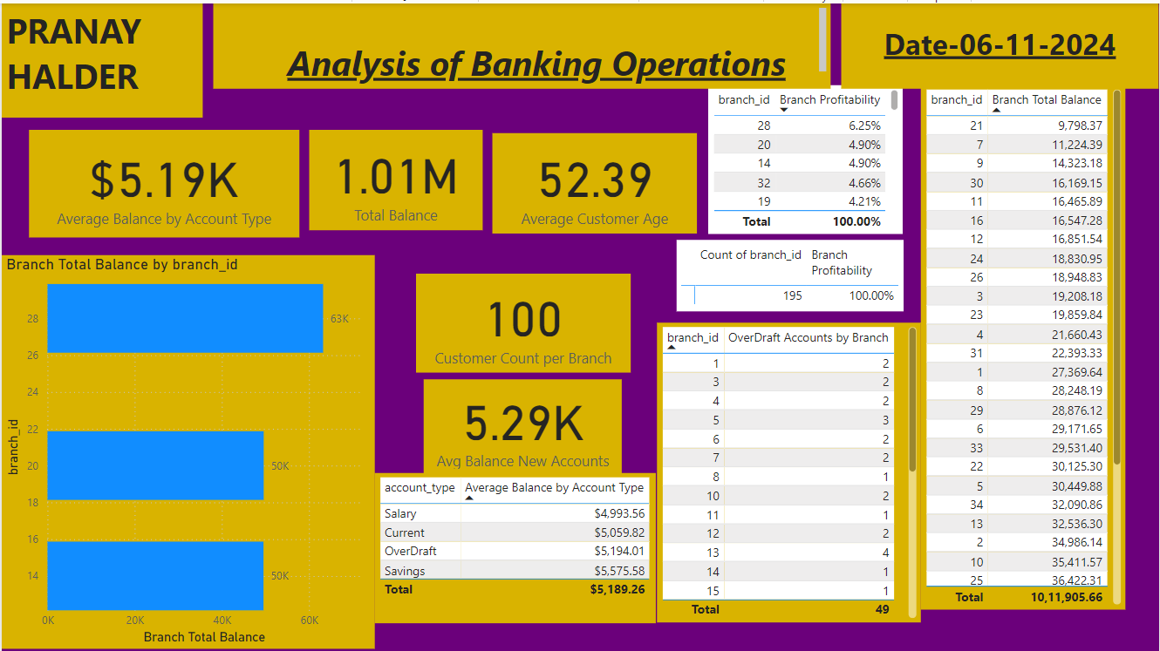

Slide 5
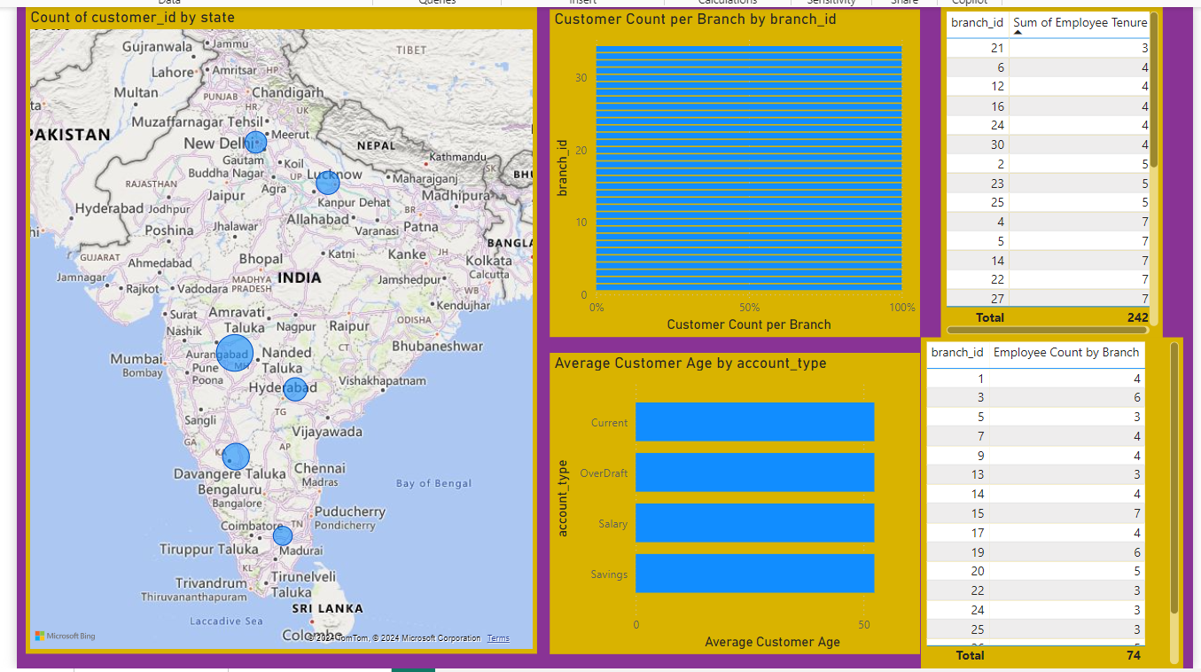

Slide 6
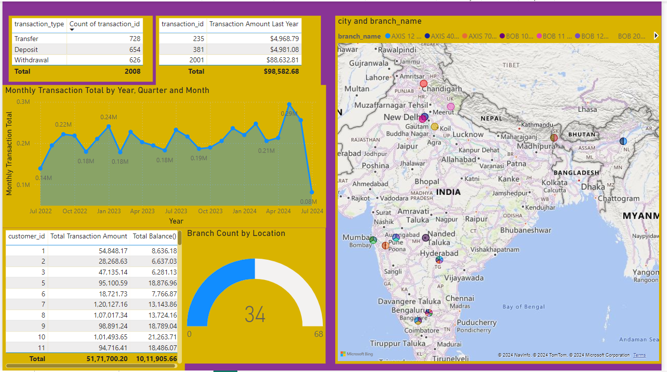

Slide 7

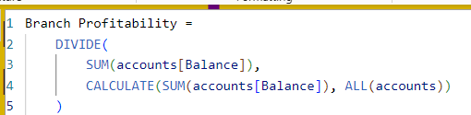
1.What is the total balance across all accounts?
2.Identify the top three branches by total account balances.
3.Calculate the average balance for each account type.
4.Create a measure that calculates total branch profitability based on account balances.
5. Highlight branches with total balances exceeding $8,000 (using a custom visual or workaround).

Slide 8
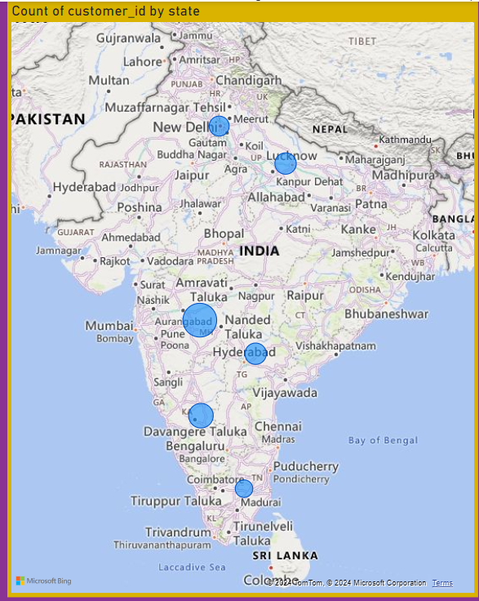
6. What is the distribution of customers by state?

Slide 9
7. Determine the average age of customers by account type.
8. Identify which branch has the highest number of customers.
9. Calculate the average tenure of employees by branch.
10. Identify branches with more than two employees.

Slide 10
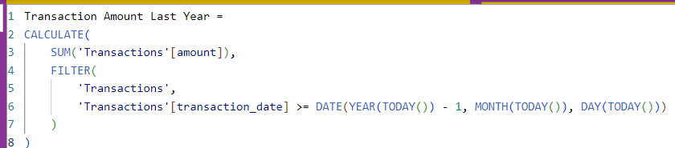
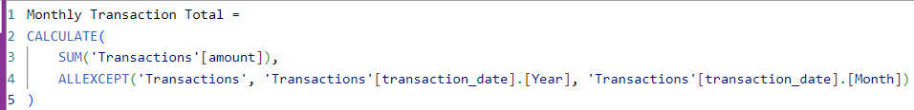
11. What is the total number of transactions for each transaction type (Deposit, Withdrawal, Transfer)?
12. Determine the top three accounts by transaction amount over the past year.
13. Create a trend line showing total transaction amounts by month.

Slide 11
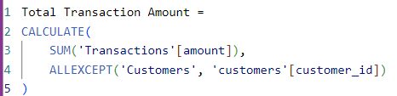
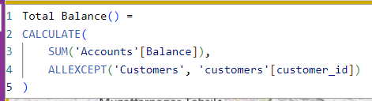
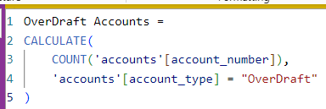
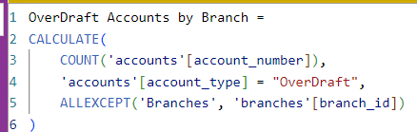
14. Identify the top three customers by transaction amounts and total balance.
15. Which branches serve the most customers with “OverDraft” accounts?

Slide 12
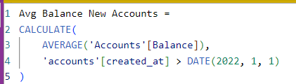

16. Find the average balance for accounts created after January 1, 2022.
17. What percentage of branches are located in urban areas versus rural areas?

Slide 13
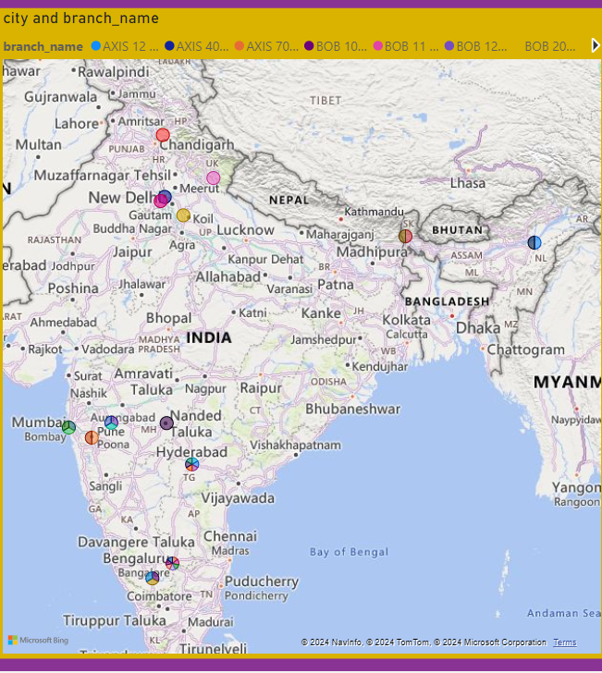
18.Create a map visualization showing branch locations and total balances.

Slide 14
Conclusion and Key Takeaways
In conclusion, optimizing banking operations through Power BI can lead to enhanced efficiency, better decision-making, and improved customer experiences. Embracing these tools is essential for future success in the banking sector.

Slide 15
Thanks!

